Slide 1
Hydroponic NFT System
By Harvey, Marlo, Colette, and Henry
Notes:
Everyone

Slide 2
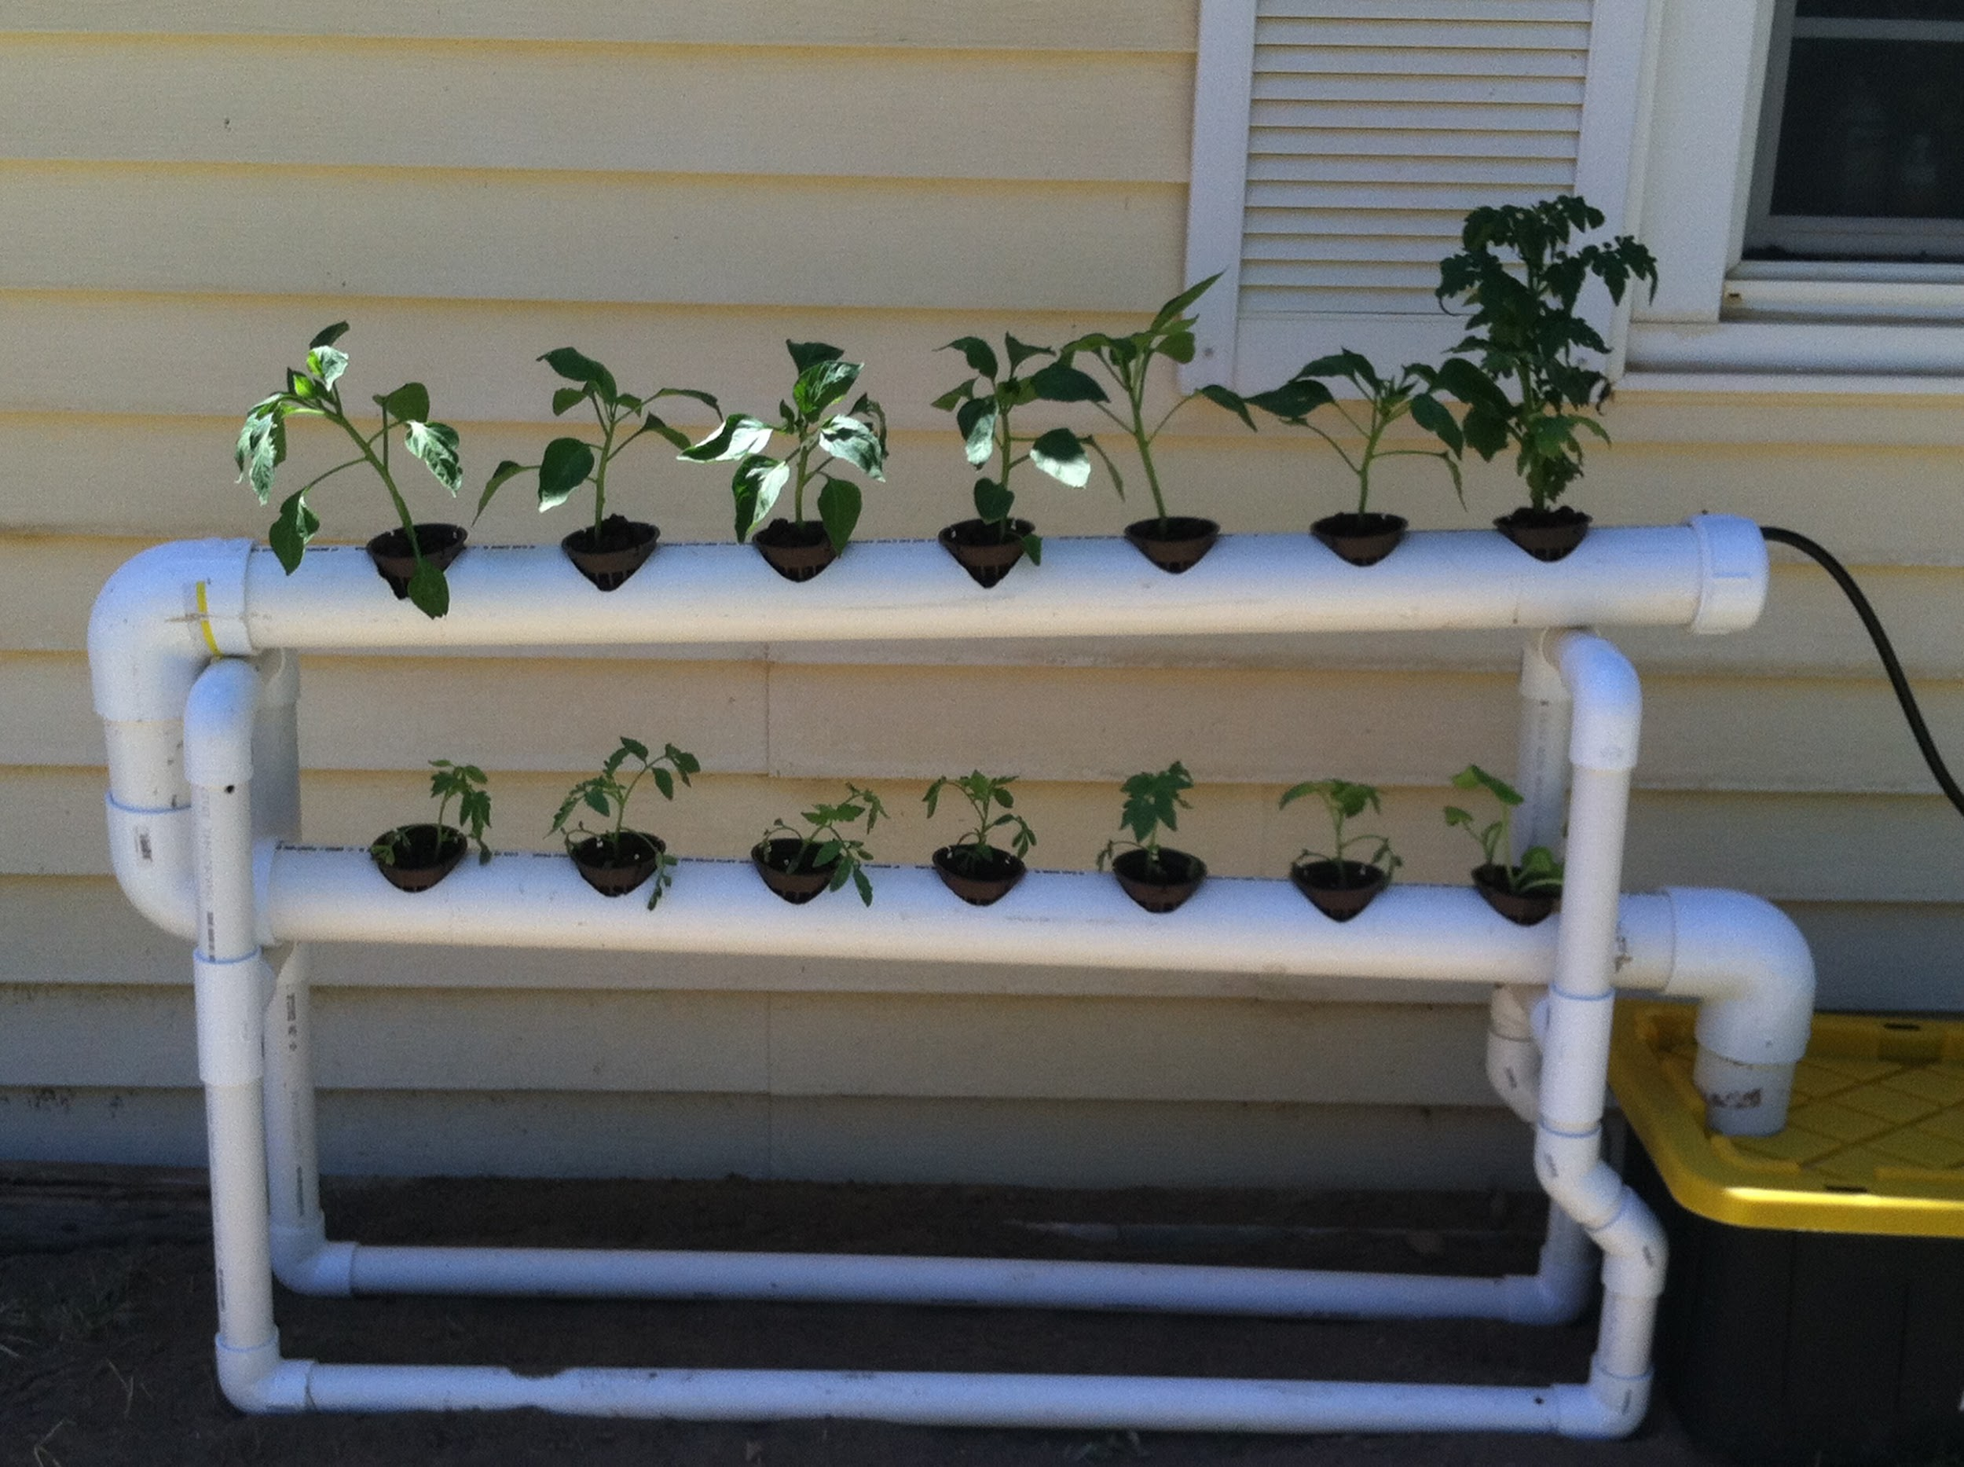
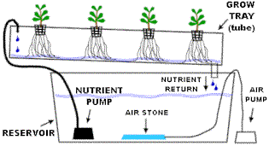
What a N.F.T. Hydroponics System Looks Like
Notes:
Written by Marlo

Slide 3
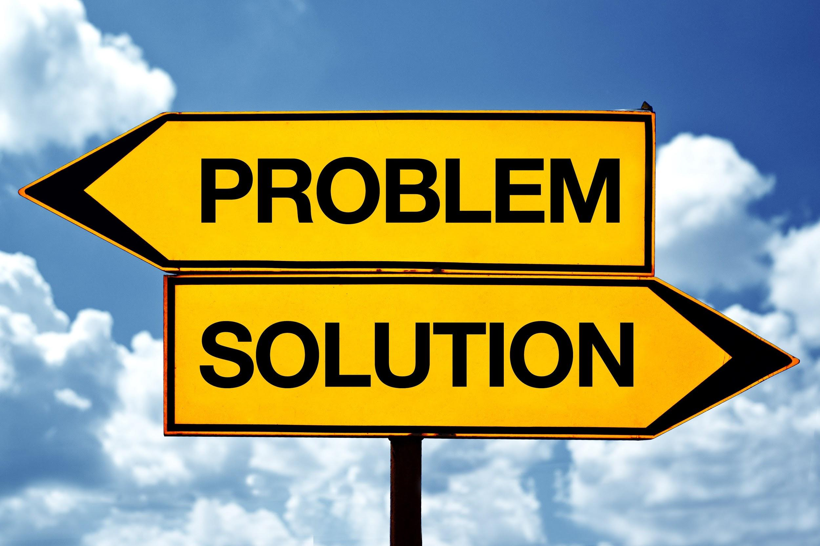
Problem
What are we trying to solve?
Notes:
WRITTEN BY HARVEY, HENRY SPEAKS- The problem that we are trying to solve is bringing plants into an urban environment. This is a problem because in the urban environment that New York City has, there is a limited amount of space. In order to solve this problem and grow new plants in the city, we decided to make a Hydroponic system. An NFT to be exact.

Slide 4
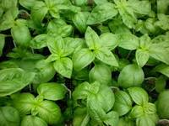
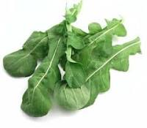
Organisms
Notes:
WRITTEN BY MARLO, MARLO SPEAKS: The organisms we are working with are basil and arugula. We chose these two because they are both edible. We chose these two plants out of all the other edible ones because they grow fast and efficiently which is important if you live off of them as a food source.

Slide 5
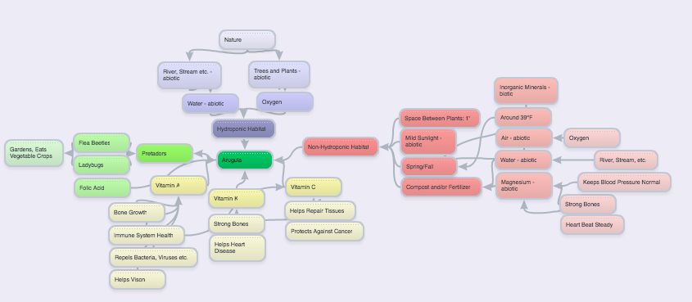
Muir Webs
Notes:
WRITTEN BY COLETTE, COLETTE SPEAKS

Slide 6
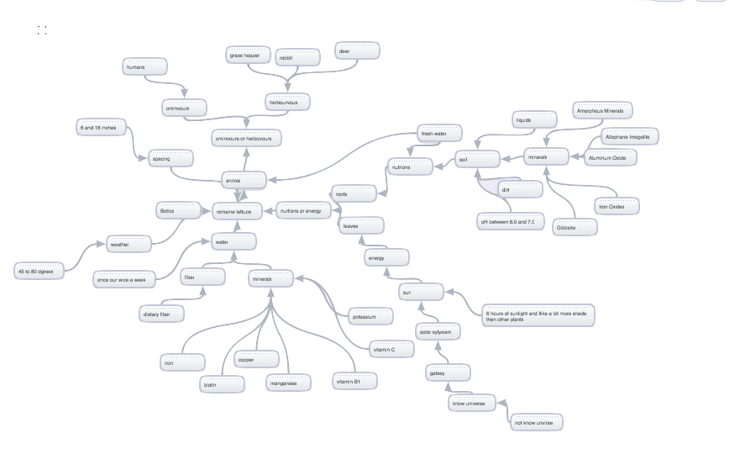
Notes:
Written by Henry, Henry speaks/ this is are muir web about romaine lettece we desided to move away from this because we did not have

Slide 7
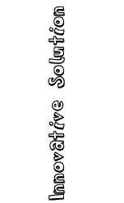
Notes:
Written by Harvey, Marlo Speaks-Our innovative solution to our problem is to grow our plants in a system which is small, homemade and cheap. We decided to run our experiment this way because these factors help us solve the original question and add helpful extra elements.

Slide 8
Experiment
Our question:
The Purpose:
Notes:
Written by Marlo and Harvey, Marlo speaks
How does the type of growing system affect the amount of leaves that romaine lettuce and arugula plants have?
Harvey speaks:
The purpose of our experiment is to figure out which of our organisms grows more leaves in a certain amount of time, basil or arugula, in a N.F.T. hydroponic system.

Slide 9
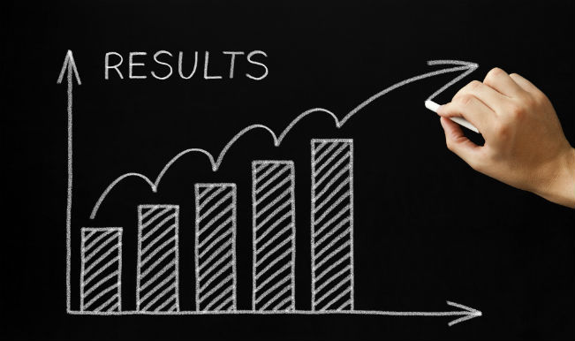
Notes:
Harvey- Sadly, our project never got a chance to fully work, but we are trying to make it work. Currently, we are at a stage where we are about to transplant our basil and arugula into our system. As a group, we believe that our project didn’t go as expected and planned because we used too much duct tape, we didn’t always focus on some of the most pressing issues, also we didn’t work in the most efficient ways, didn’t come to work during extra times, and didn’t show enough effort and enthusiasm when we came.

Slide 10
Notes:
Harvey- Like we have said, we cannot draw a conclusion from our plant data, but we know that if we were to run this experiment again or recommend it to someone else, we would make a detailed plan for them to set up so they wouldn’t have to deal with the issues that we had to work with. We also would run our experiment But we managed to conclude that our hydroponics system will solve our original question, and it WILL be a good way to bring more plants into the city environment because it worked for a brief amount of time.

